Slide 1
Conference report CSH meeting – systems biology: global regulation of gene expression 20-23 March, 2012
Yaron Orenstein
ACGT group meeting
23rd May, 2012

Slide 2
Cold Spring Harbor
Located on the north shore of Long Island.
Next to a whaling town.

Slide 3
Cold Spring Harbor Laboratory
Founded in 1890, holding meetings since.
Leading biological research center.
5 Nobel prize winners, 25 including alumni.
DNA double-helix structure discovered there.
Watson still has an office.

Slide 4
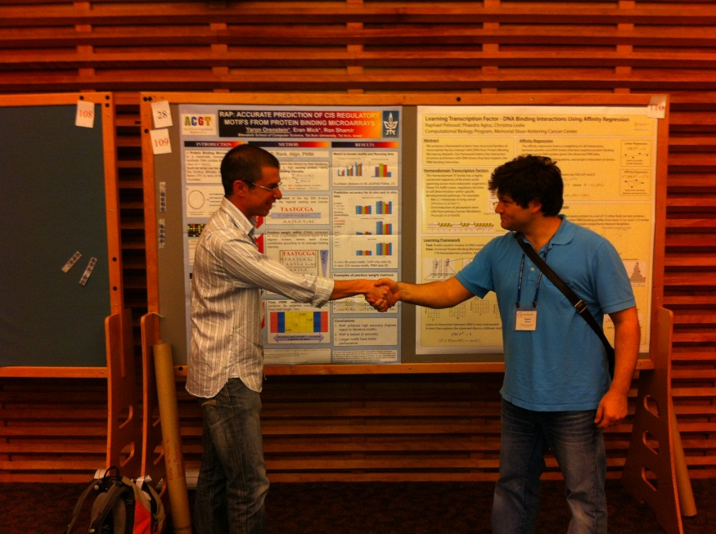
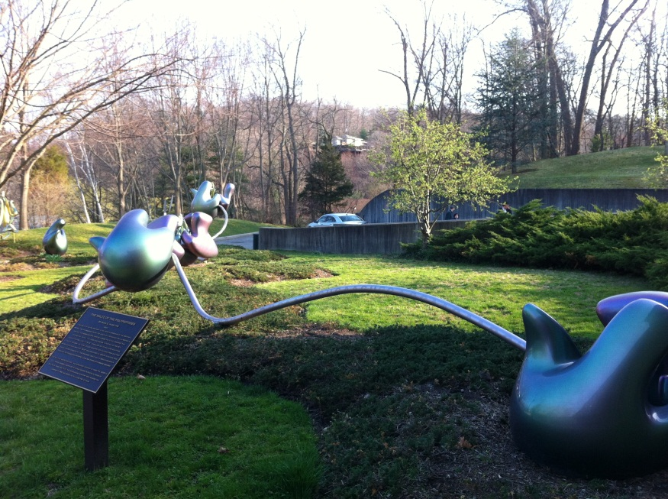
CSH meetings
Held on campus, including housing.
Include morning and evening sessions.
In-between, posters.
Social activities: lobster banquet, cheese & wine party, dance club, pub every night.

Slide 5
ChIP-exo
Comprehensive Genome-wide Protein-DNA Interactions Detected at Single-Nucleotide Resolution
Ho Sung Rhee, B. Franklin Pugh
The Pennsylvania State University
Cell, December 2011

Slide 6
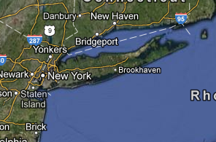
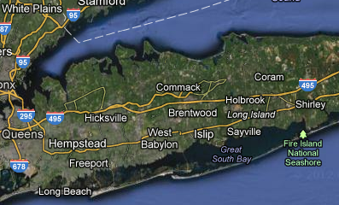
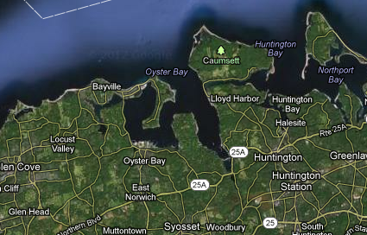
Zooming in

Slide 7
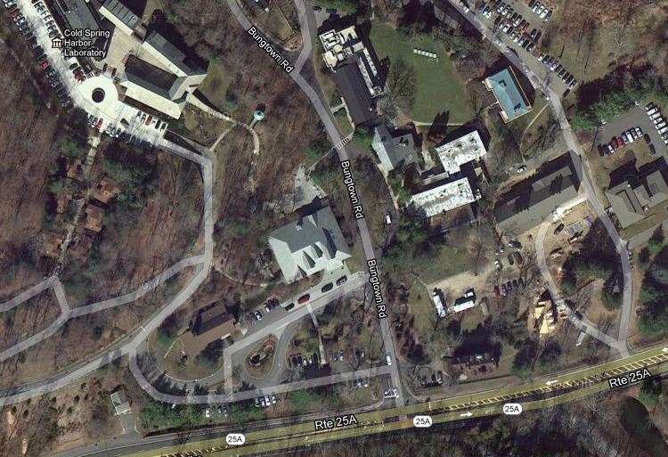
Zooming in – cont’d

Slide 8
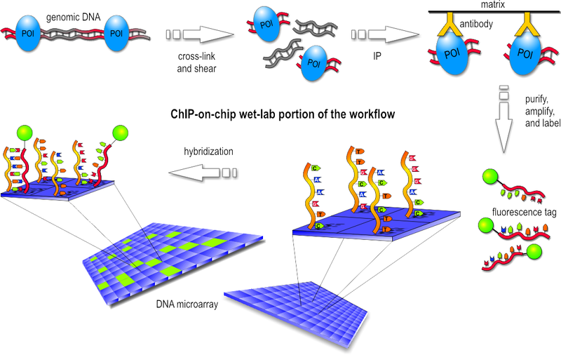
Chromatin Immunoprecipitation

Slide 9
Limitations of previous methods
ChIP: Many false positive.
Misses low-affinity binding (false negative).
Cannot detect clusters of binding.
Hard to extract binding site due to TF variability and degeneracy.
PBM: solves this, but in vitro.
Digital genomic footprinting: requires prior knowledge of which proteins bind to sequences.

Slide 10
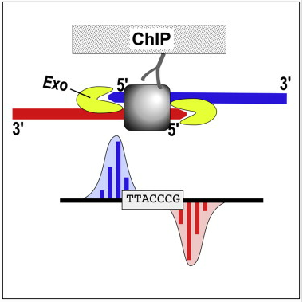
The idea of ChIP-exo
The protein blocks a lambda (λ) exonuclease.
Deep-sequence the exposed sequences.
Map to reference genome.

Slide 11
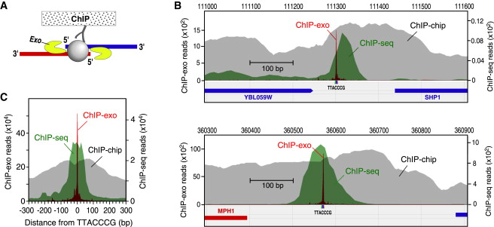
Preliminary Results
B) Reb1 at specific loci (TTACCCG).
C) Aggregation of Reb1 over 791 locations.

Slide 12
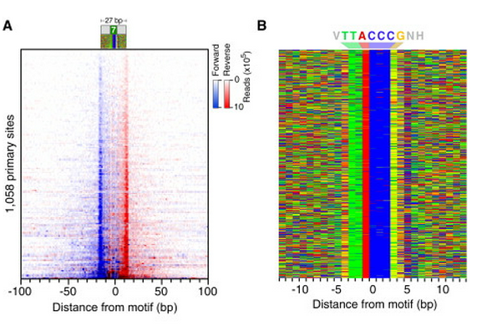
Mapping accuracy and sensitivity
(A) Raw sequencing tag distribution around 1,058 primary Reb1-bound locations.
(B) Color chart representation of 27 bp of DNA sequence.

Slide 13
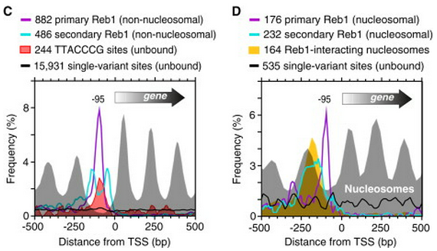
Highly Organized Secondary Interactions
Secondary = less-occupied within 100 bp of a more-occupied
(C) Unoccupied primary and secondary sites.
(D) Occupied primary and secondary sites.

Slide 14
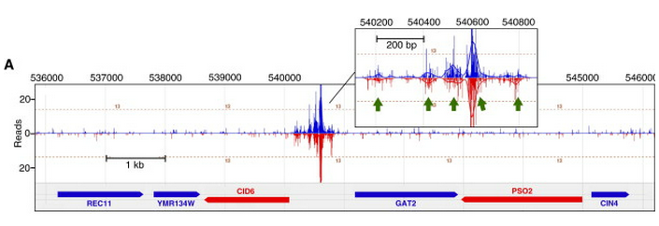
Other results
The paper describes more examples on:
Nucleosome-TF binding interactions.
Secondary binding sites.
TF binding variability and degeneracy.
And many more…

Slide 15
Summary
ChIP-exo can reveal a set of genomic binding locations for a protein at single bp accuracy.
Provides a much greater range of occupancy levels that can be detected.
Enables a better assessment of regulatory networks, the repertoire of binding sites, their evolutionary turnover, and the context in which they interact with other factors.

Slide 16
Finding structural motifs in mRNA
Systematic discovery of structural elements governing stability of mammalian messenger RNAs
Nature, March 2012
Computational people: Hani Goodarzi, Panos Oikonomou, Saeed Tavazoie (Princeton)

Slide 17
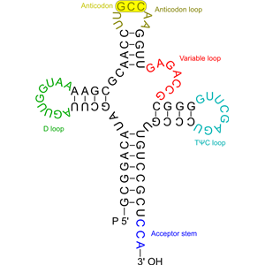
mRNAs
Messenger RNAs are gene transcripts.
They are a sequence of A, C, G, U.
Their secondary structure is the base-pairing of A-U and C-G.
Contain regulatory elements for post-transcriptional regulation.

Slide 18
Biological introduction
Local RNA secondary structure interact in a variety of regulatory contexts, including:
1) Transcript stability (Rabani et al. 08).
2) Alternative splicing (Barash et al. 10).
3) Localization (Rabani et al. 08).
Understanding post-transcriptional regulations requires capturing the structure and sequence.

Slide 19
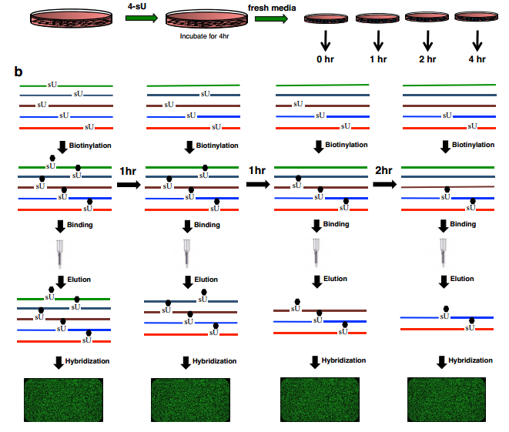
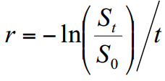
How to measure stability?
Incubating human breast cancer cells.
S_{t} = signal at time t
r = decay rate

Slide 20
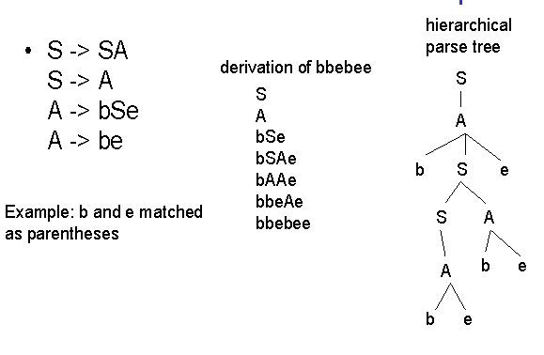
Reminder: context free grammar
Production rule is of the form V -> w
V is a single nonterminal symbol
w is a string of terminals and/or nonterminals (w can be Ø)

Slide 21
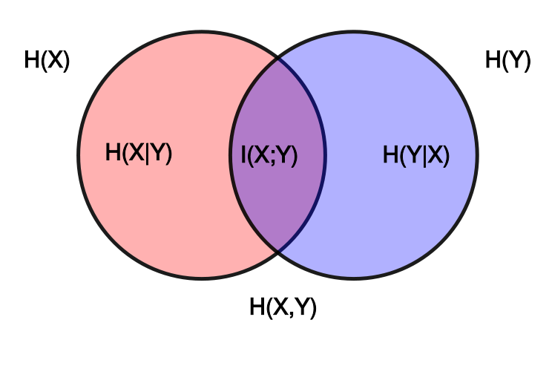
Reminder: mutual information
A quantity that measures the mutual dependence of the two random variables.
The relation to entropy:

Slide 22
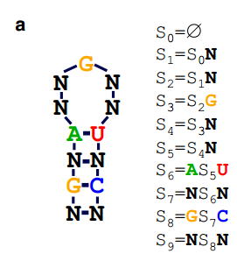
TEISER = Tool for Eliciting Informative Structural Elements in RNA
Genome profile = a measurement for each gene.
Structural motif = a series of context-free statements.
G5 | G4 | G3 | G2 | G1
7.8 | 0.5 | 1.2 | 5.2 | 3.4
Motif profile = binary vector of all genes (1 for presence).
Short stem-loop structures along with a known primary sequence.
G5 | G4 | G3 | G2 | G1
0 | 0 | 1 | 0 | 1

Slide 23
TEISER overview
Create seed CFGs.
Quantize continuous genome profiles.
Remove duplicated genes.
Calculate MI for each motif candidate.
Filter motifs based on statistical testing.
Optimize and elongate motifs.
Remove redundant motifs.
Filter motifs based on robustness testing.
Filter motifs based on enrichment testing.

Slide 24
Post-processing steps
Calculate inter-species conservation.
Find potentially active instances of each motif.
Predict functional interactions.

Slide 25
Creating seed CFGs
Seed motifs: an exhaustive set of context-free statements that represent all possible stem-loop structures:
Stem length 4-7 bp.
Loop length 4-9 nt.
4-6 production rules representing non-degenerate bases (are not SSN, SNS, or SNSN);
Information content of 14-20 bits.

Slide 26
Information content
−log₂(p_{M})
p_{M} is the probability that a random (?) sequence of length l matches the n production rules of motif M.
l = 2 × n₁ + n₂ .
n₁ = #rules that represent base pairings.
n₂ = #rules that represent bulges (n₁ + n₂ = n).

Slide 27
Quantizing continuous genome profiles
Equally populated ‘bins’.
Default number of bins set to 30 (N_{e} = 30).
Results are not sensitive to variations in the value of N_{e} as long as N_{e} is >10 and each bin has more than ~100 associated transcripts.
G5 | G4 | G3 | G2 | G1
7.8 | 0.5 | 1.2 | 5.2 | 3.4
G5 | G4 | G3 | G2 | G1
b2 | b20 | b3 | b5 | b4

Slide 28
Removing recently duplicated genes
Duplicates = sequences that are almost identical.
Remove the duplicates that have similar values (for example, fall in the same bin after quantization of the input genome profile).
A MegaBlast E-value cutoff of 1 × 10⁻¹⁵ was used to identify duplicates.

Slide 29
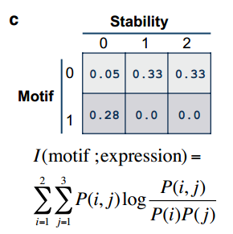
Calculating mutual information values
Mutual information (MI) calculations between the genome profile and the motif profiles.

Slide 30
Randomization-based statistical testing
The genome profile is shuffled 1.5∙10⁶ times and MI values are calculated.
Significant = the real MI value is greater than all of the randomly generated ones.
Structural motifs are first sorted based on the MI values (from high to low). When 20 contiguous motifs in the sorted list do not pass the test, halt.

Slide 31
Optimization of the identified seeds into more informative motifs
Randomly choose one of the context-free rules from the motif
Convert its sequence information to all possible combinations of nucleotides.
Evaluate all the resulting structural motifs and accept the one that results in the highest MI value.

Slide 32
Elongation
Production rules are added to the end of the context-free phrase that represents the motif,
This extends its effective length in the form of a base pair or a bulge.
The increase in length is similarly accepted only if it results in a higher MI value.

Slide 33
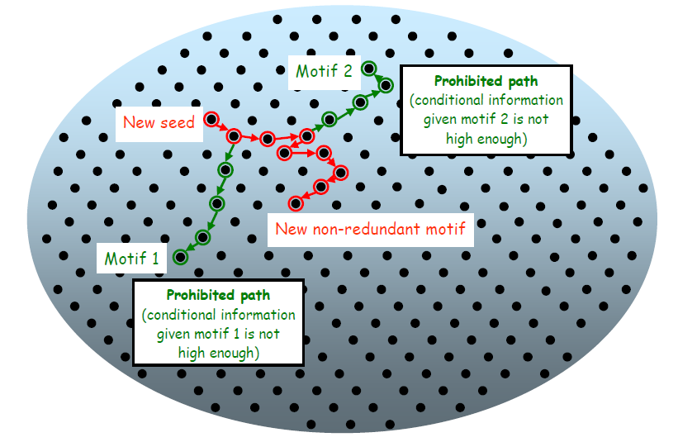
Optimization in a figure
Slonim et al. 07

Slide 34
Remove redundantly informative structural motifs
Identify motifs that represent the same potential cis-regulatory elements using conditional information (Slonim et al. 07):
I(motif ; profile|prev_motif) = conditional information.
I(motif ; prev_motif) = information between the motifs profile.
r is a tradeoff parameter.

Slide 35
Finding robust motifs
For each predicted motif:
Perform 10 jackknifing trials where, in each trial, 1/3 of the genes are randomly removed and the MI and its statistical significance is evaluated.
The robustness score = #trials in which the motif remains significant after resampling.
By default, TEISER requires the motif to be significant in more than half of the trials.

Slide 36
Final statistical tests
Calculate the enrichment score (e.g. hypergeomentric) of motif targets across the genome profile.
Calculate the Spearman correlation between the enrichment scores and the average data value across all the bins.
The goal is to identify the motifs that show significant enrichments at either end of the data range.

Slide 37
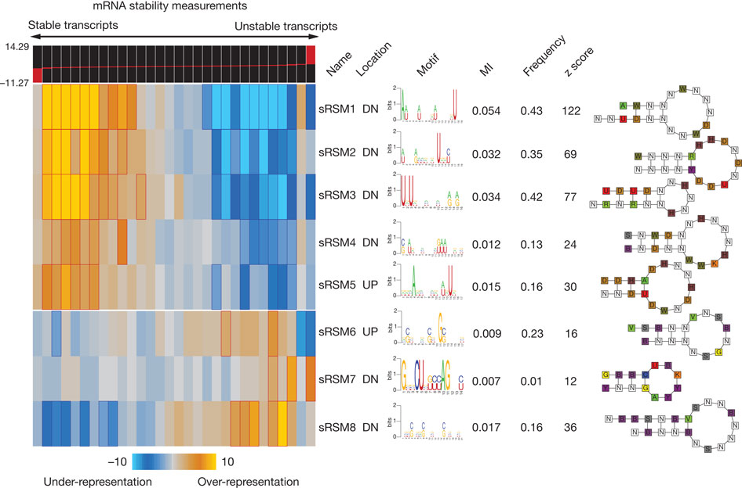
TEISER output

Slide 38
Inter-species conservation
For each motif, calculate a conservation score based on its network-level conservation with respect to a related genome.
Orthologous transcripts in both genomes are scanned for the presence/absence of the motif.
Hypergeometric p-value is calculated based on the overlap of positive sequences.

Slide 39
Finding potentially active instances of each motif
Target genes = transcripts whose 3′ or 5′ UTRs contain the motif and are associated with a category/bin where the motif is enriched.
Generate a weight-matrix from these potentially functional.

Slide 40
False-discovery rate
30 trials with shuffled 5′ and 3′ UTR sequences.
In all the trials, not a single motif passed all the statistical tests.
Thus, in case of the stability data set, the number of false positives in each trial, on average, is smaller than 1/30 ≈ 0.034, which corresponds to an FDR of <0.01.

Slide 41
Predicting functional interactions
Measuring how informative the presence of one motif would be about the presence or absence of the other.
Mutual information values calculated for pairwise motif profiles of structural and linear motifs.
One of the motif profiles is shuffled 10,000 times and the interaction is deemed significant only if the real mutual information value is higher than all the 10,000 random ones.

Slide 42
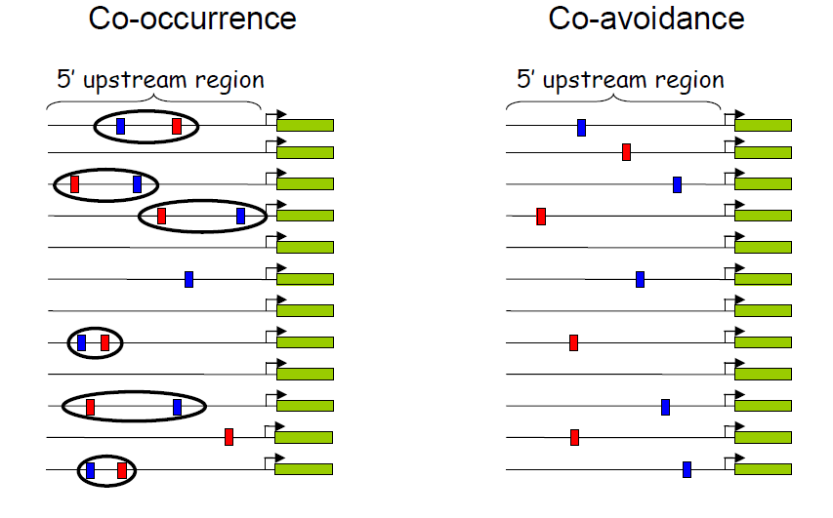
Co-occurrence in figures
Slonim et al. 07

Slide 43
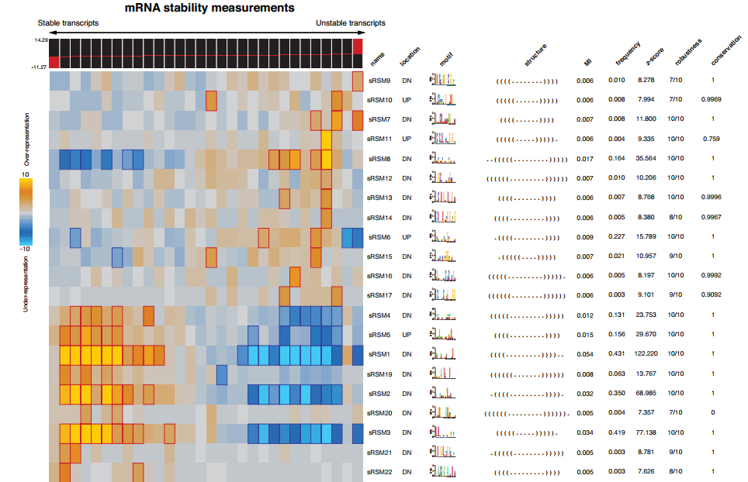
More detailed output

Slide 44
Summary
(skipped biological validation).
A computational framework based on context-free grammars, and mutual information.
Systematically explores the immense space of small structural elements.
Reveals motifs that are significantly informative of genome-wide measurements of RNA behavior.

